Slide 1
Bus Reservation System
Name : Ruchika Thakur
Branch / Sem : CSE Sem 2
Roll no. : C021352

Slide 2
Table of contents
01
02
03
04
Introduction
Information
Explaining about problem and the program to solve that problem
Functionalities of the program
Source Code
Functions , header files and classes used
Structure and working
Code and output on console sreen

Slide 3
Bus Reservation System
As the name suggests Bus Reservation System is the project that handles entire booking data of the bus.
It helps the passengers to reserve seats in bus and to know the details like bus drivers name , departure time and place, arrival time and place , and seats available.
It also helps the company employee to keep the record of customers and to install any new buses available on some route.
Basically it will keep track of all passenger’s information, bus information, and reservation information

Slide 4
Why is Bus Reservation System Needed?
Improve Efficiency
Improve Security
Improve accuracy
Decreases dependability
Saves Time
Cost Reduces

Slide 5
Functionalities
Add Bus number to install a new bus
Reservation of seats
Show seats available
Show Buses available

Slide 6
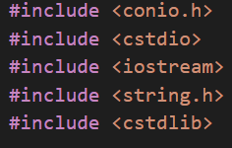
Source Code and Working of Project
This program is created using C++ Object Oriented Programming Language.
There are 5 header files used in this program :
conio.h
Cstdio
iostream
string.h
Cstdlib

Slide 7
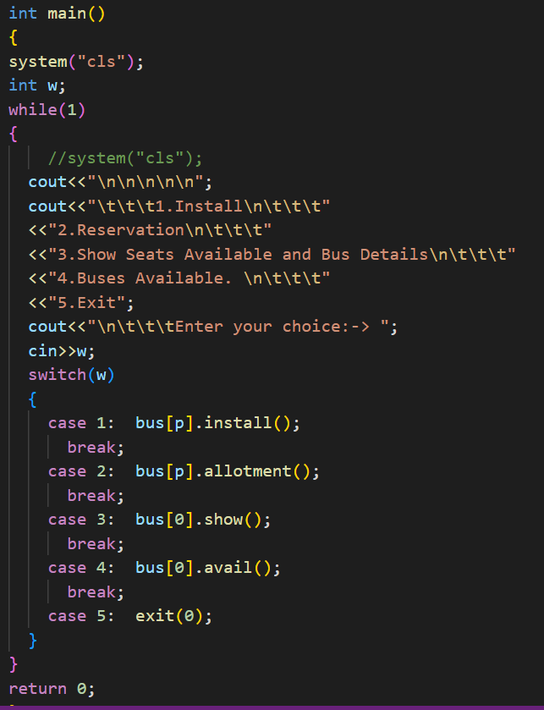
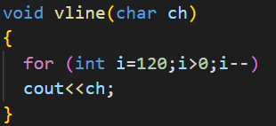
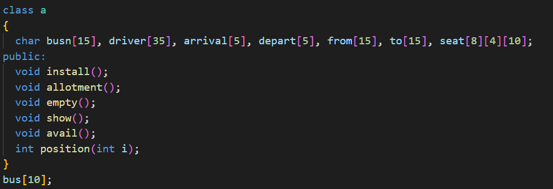
It consists of 8 function :
A main function
1 global function
6 functions in class a

Slide 8
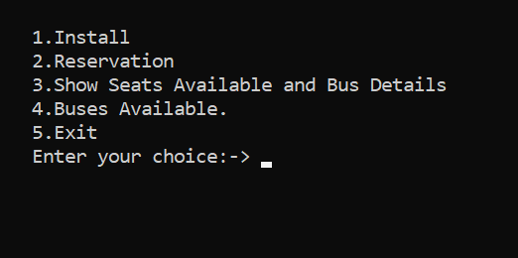
Main Menu Screen Window

Slide 9
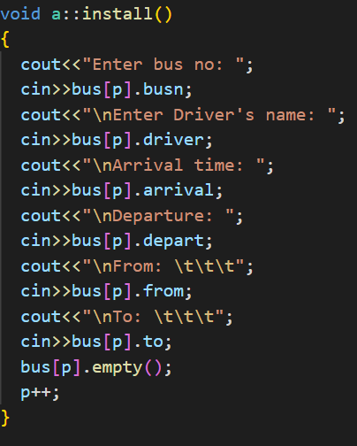
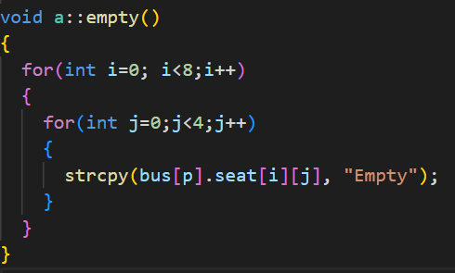
Add Bus ( install() )
This function is used to install a new bus using a new number.
As it is a function of class a, it uses objects of class a using Object bus[].
It also uses empty() function .

Slide 10
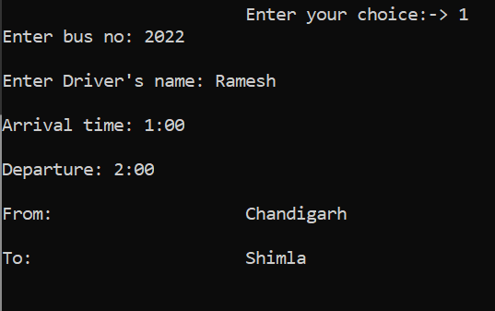
The Bus no.
Name of the driver
Time of Arrival
Time of Departure
The location from which
bus will departure.
The arrival location

Slide 11
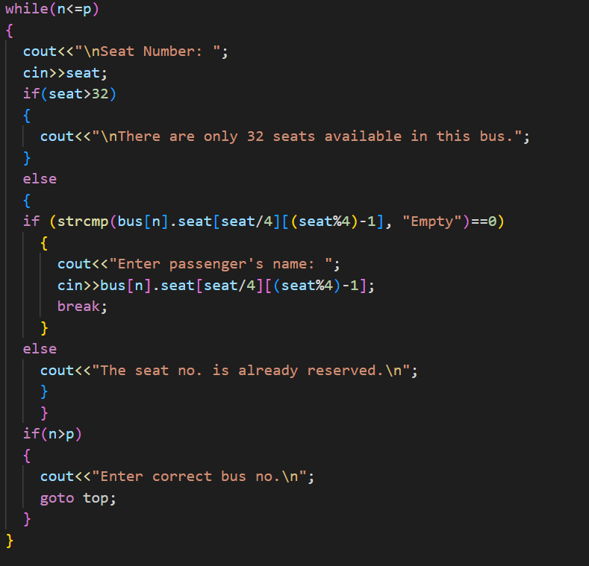
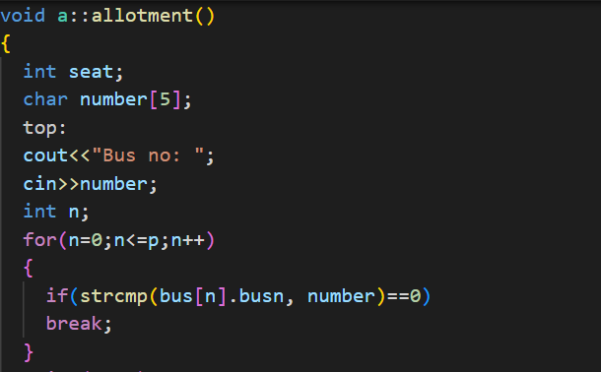
Bus Reservation ( allotment() )
This function is used to reserve seat in the chosen bus if available
using if-else statement , for and while
loop.

Slide 12
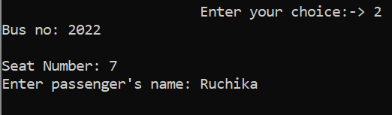

Slide 13
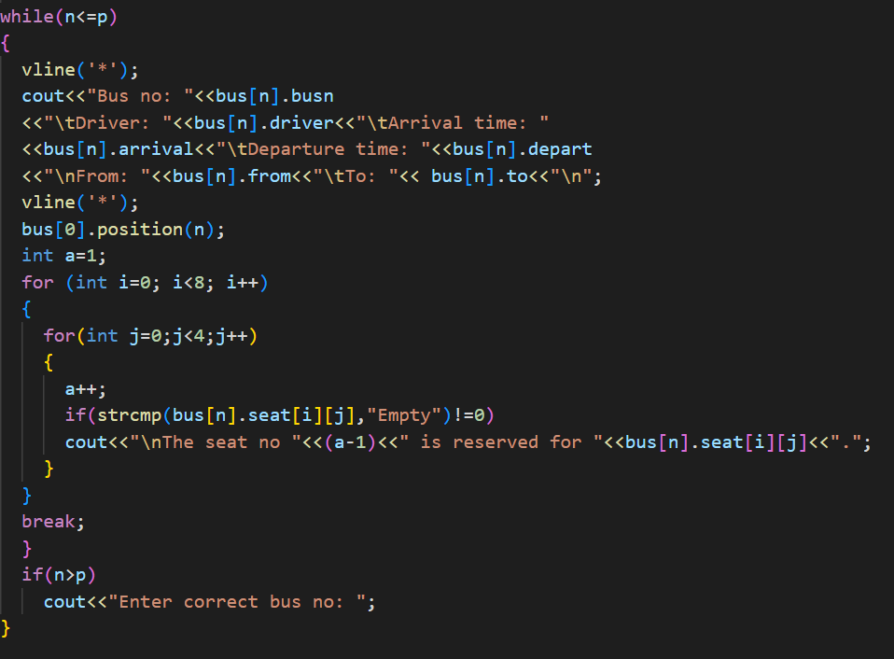
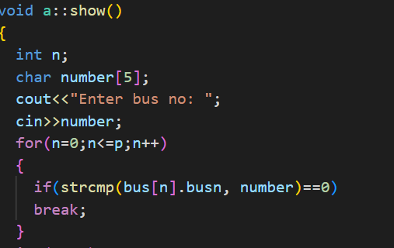
show()
This function is for showing seats available in the bus whose information is required.
It is also uses vline ()
global function.

Slide 14
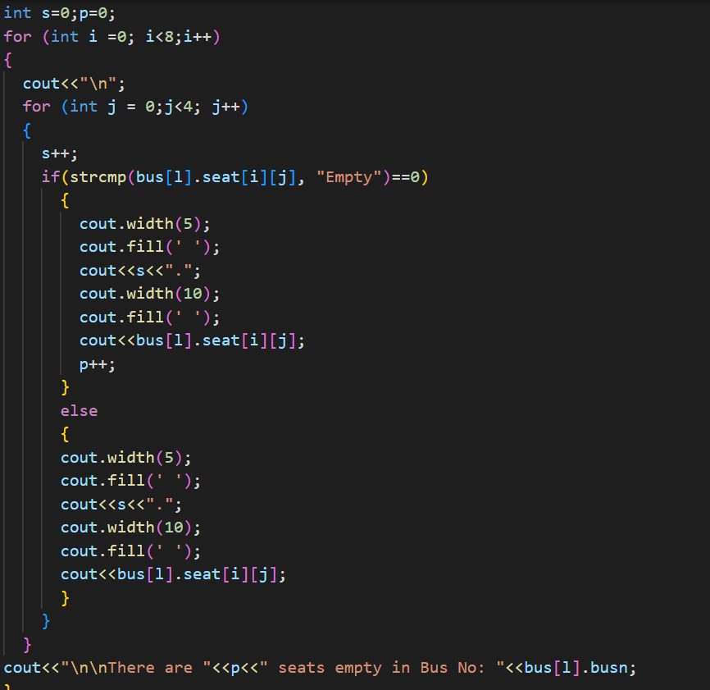
Also it uses position() which is for filling the name of the passenger at right seat place and to show empty place at the seat which are available for reservation.

Slide 15
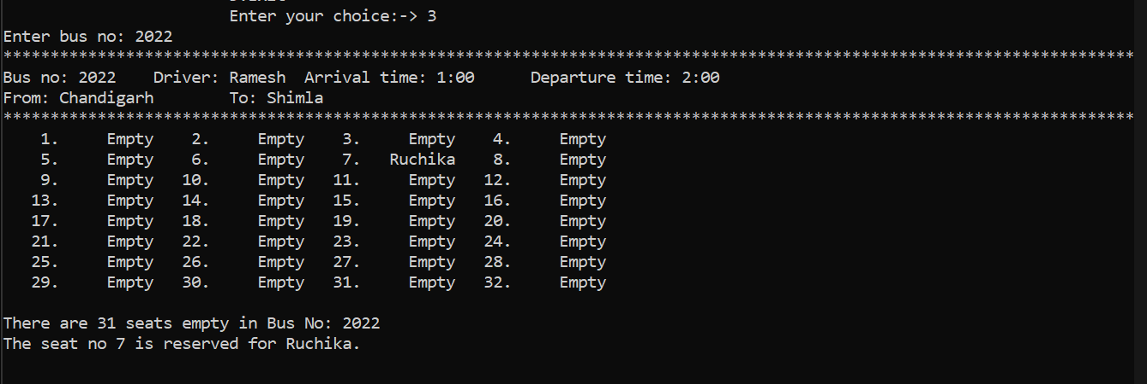

Slide 16
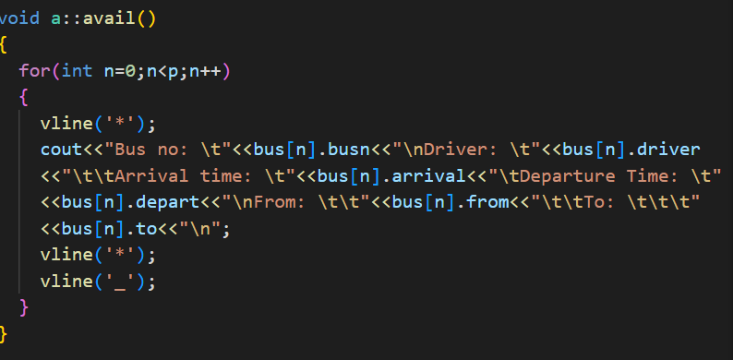
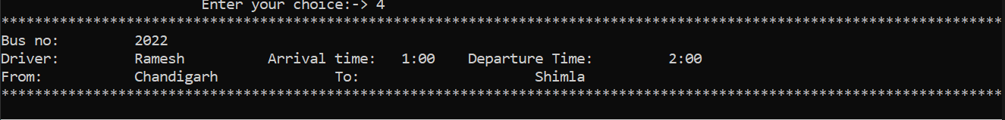
Buses Available (avail() )
This function is used to check availability
of bus of the required route.
Console Screen

Slide 17
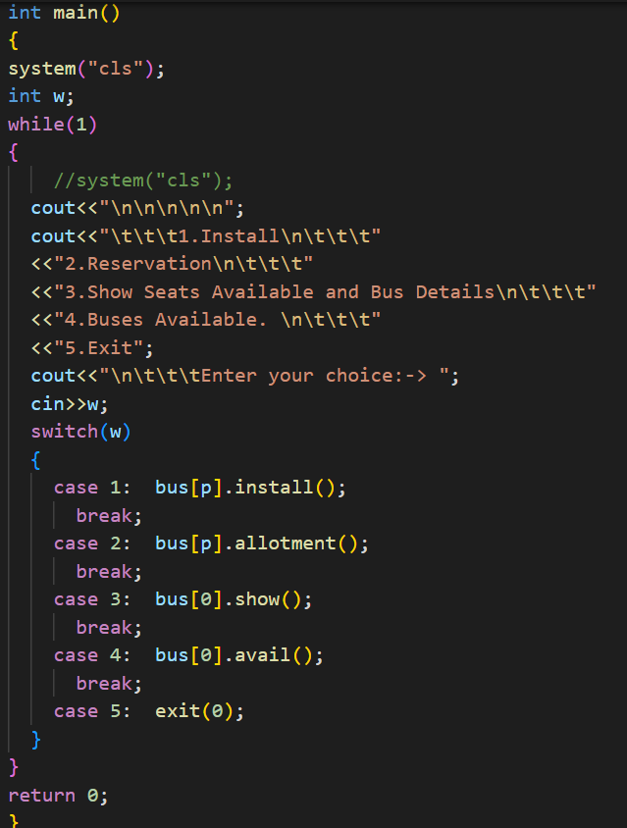
int main()
At last there is main function which uses all the mentioned function till now.
It uses Switch case statements to execute the required function or choice.

Slide 18
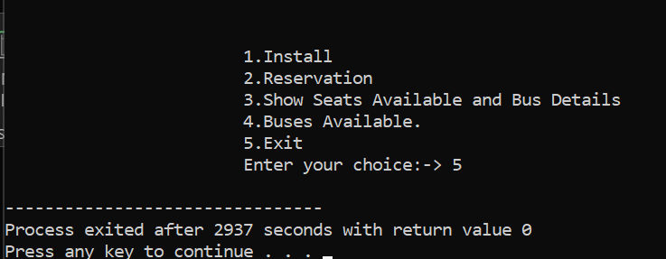
Exit
By choosing 5th option the bus reservation will be closed.

